Slide 1
Suffix arrays
By Muhammad Shah Khan

Slide 2
What is a suffix array?
A suffix array stores the starting indices of all suffixes of a string after the suffixes are sorted in lexicographical order.

Slide 3
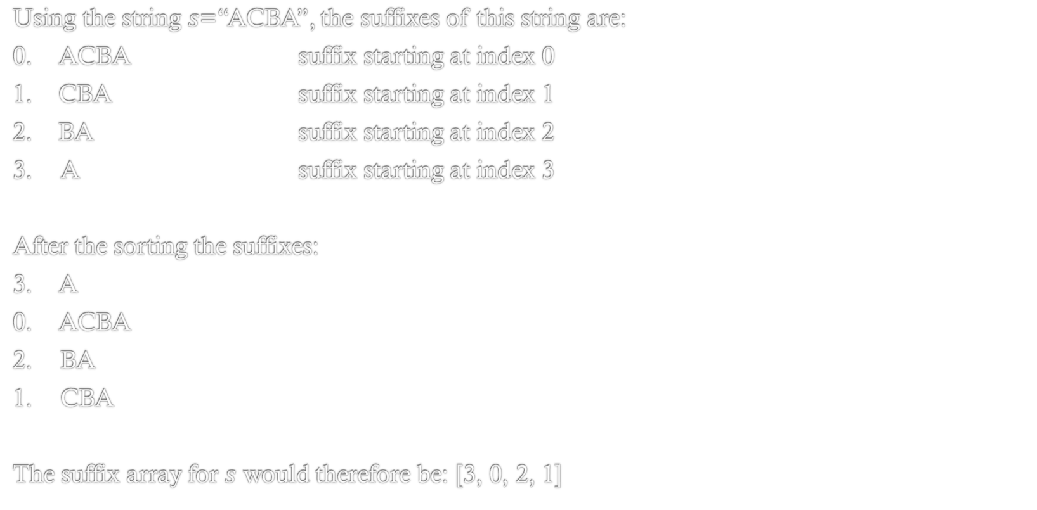
Example of suffix array
Using the string $s$=“ACBA”, the suffixes of this string are:
0. ACBA suffix starting at index 0
1. CBA suffix starting at index 1
2. BA suffix starting at index 2
3. A suffix starting at index 3
After the sorting the suffixes:
3. A
0. ACBA
2. BA
1. CBA
The suffix array for $s$ would therefore be: [3, 0, 2, 1]

Slide 4


$O(n^{2}\log{n})$ approach
Store each suffix in an array, together with its starting index, and sort the array using the standard sort algorithm.
Has a time complexity of $O(n^{2}\log{n})$ as there are $O(n\log{n})$ comparisons and comparing two strings takes $O(n)$ time.

Slide 5
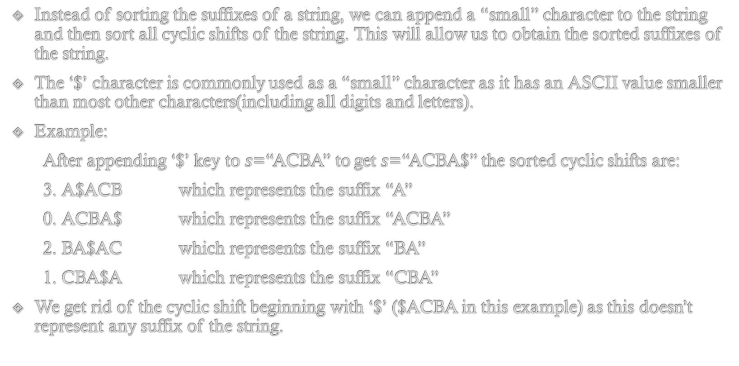
$O(n\log{n})$ approach
Instead of sorting the suffixes of a string, we can append a “small” character to the string and then sort all cyclic shifts of the string. This will allow us to obtain the sorted suffixes of the string.
The ‘$’ character is commonly used as a “small” character as it has an ASCII value smaller than most other characters(including all digits and letters).
Example:
After appending ‘$’ key to $s$=“ACBA” to get $s$=“ACBA$” the sorted cyclic shifts are:
3. A$ACB which represents the suffix “A”
0. ACBA$ which represents the suffix “ACBA”
2. BA$AC which represents the suffix “BA”
1. CBA$A which represents the suffix “CBA”
We get rid of the cyclic shift beginning with ‘$’ ($ACBA in this example) as this doesn’t represent any suffix of the string.

Slide 6
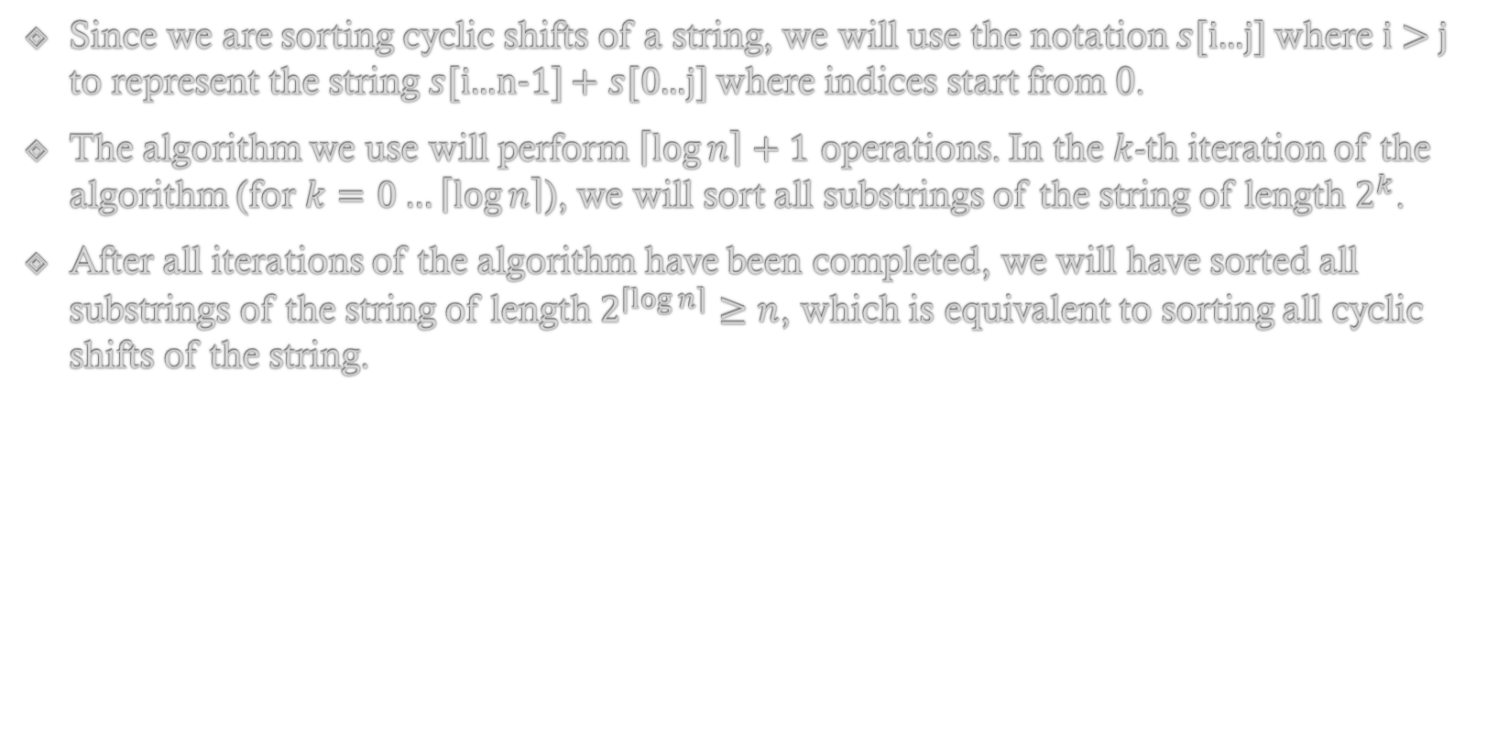
$O(n\log{n})$ approach (continued)
Since we are sorting cyclic shifts of a string, we will use the notation $s$[i...j] where i > j to represent the string $s$[i...n-1] + $s$[0...j] where indices start from 0.
The algorithm we use will perform $\left\lceil \log{n}\right\rceil +1$ operations. In the $k$-th iteration of the algorithm (for $k=0…\left\lceil \log{n}\right\rceil$), we will sort all substrings of the string of length $2^{k}$.
After all iterations of the algorithm have been completed, we will have sorted all substrings of the string of length$2^{\left\lceil \log{n}\right\rceil }≥n$, which is equivalent to sorting all cyclic shifts of the string.

Slide 7
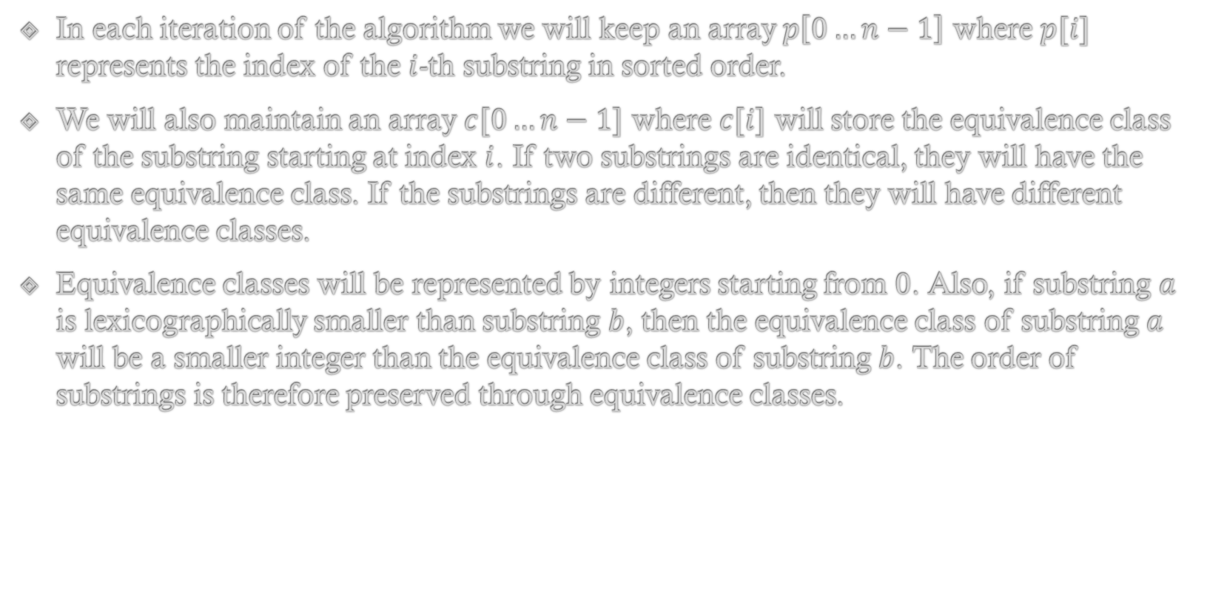
$O(n\log{n})$ approach (continued)
In each iteration of the algorithm we will keep an array $p\left[0…n−1\right]$ where $p[i]$ represents the index of the $i$-th substring in sorted order.
We will also maintain an array $c[0…n−1]$ where $c[i]$ will store the equivalence class of the substring starting at index $i$. If two substrings are identical, they will have the same equivalence class. If the substrings are different, then they will have different equivalence classes.
Equivalence classes will be represented by integers starting from $0$. Also, if substring $a$ is lexicographically smaller than substring $b$, then the equivalence class of substring $a$ will be a smaller integer than the equivalence class of substring $b$. The order of substrings is therefore preserved through equivalence classes.

Slide 8
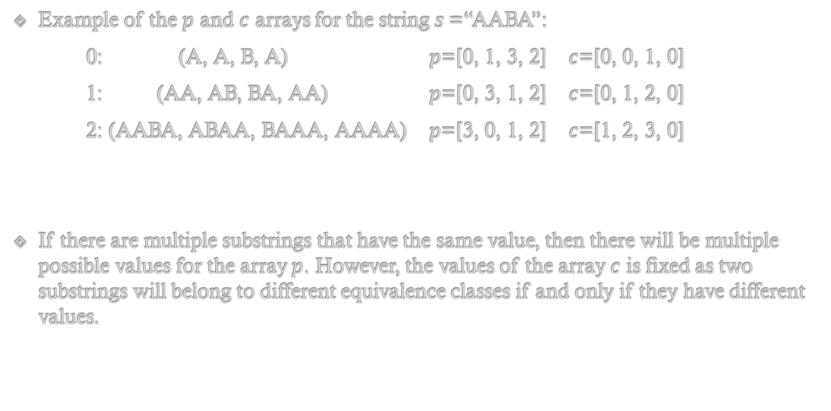
$O(n\log{n})$ approach (continued)
Example of the $p$ and $c$ arrays for the string $s$=“AABA”:
0: (A, A, B, A) $p$=[0, 1, 3, 2] $c$=[0, 0, 1, 0]
1: (AA, AB, BA, AA) $p$=[0, 3, 1, 2] $c$=[0, 1, 2, 0]
2: (AABA, ABAA, BAAA, AAAA) $p$=[3, 0, 1, 2] $c$=[1, 2, 3, 0]
If there are multiple substrings that have the same value, then there will be multiple possible values for the array $p$. However, the values of the array $c$ is fixed as two substrings will belong to different equivalence classes if and only if they have different values.

Slide 9
$O(n\log{n})$ approach C++ implemenation
vector<int> sort_cyclic_shifts(string const& s) {
int n = s.size();
const int alphabet = 256;
vector<int> p(n), c(n), cnt(max(alphabet, n), 0);
for (int i = 0; i < n; i++)
cnt[s[i]]++;
for (int i = 1; i < alphabet; i++)
cnt[i] += cnt[i-1];
for (int i = 0; i < n; i++)
p[--cnt[s[i]]] = i;
c[p[0]] = 0;
int classes = 1;
for (int i = 1; i < n; i++) {
if (s[p[i]] != s[p[i-1]])
classes++;
c[p[i]] = classes - 1;
}

Slide 10
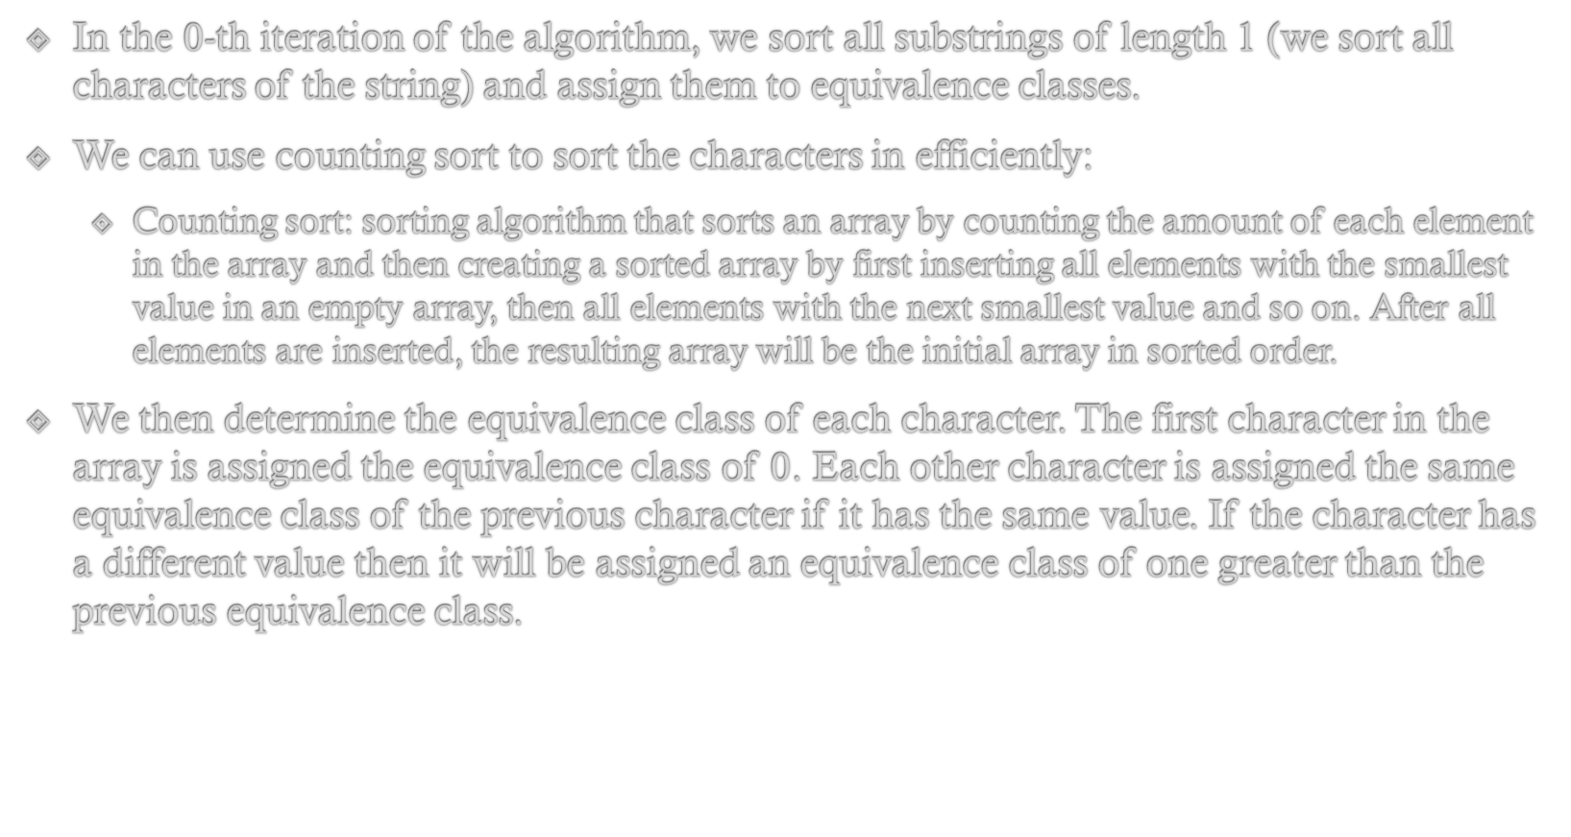
$O(n\log{n})$ approach (continued)
In the $0$-th iteration of the algorithm, we sort all substrings of length 1 (we sort all characters of the string) and assign them to equivalence classes.
We can use counting sort to sort the characters in efficiently:
  Counting sort: sorting algorithm that sorts an array by counting the amount of each element in the array and then creating a sorted array by first inserting all elements with the smallest value in an empty array, then all elements with the next smallest value and so on. After all elements are inserted, the resulting array will be the initial array in sorted order.
We then determine the equivalence class of each character. The first character in the array is assigned the equivalence class of $0$. Each other character is assigned the same equivalence class of the previous character if it has the same value. If the character has a different value then it will be assigned an equivalence class of one greater than the previous equivalence class.

Slide 11
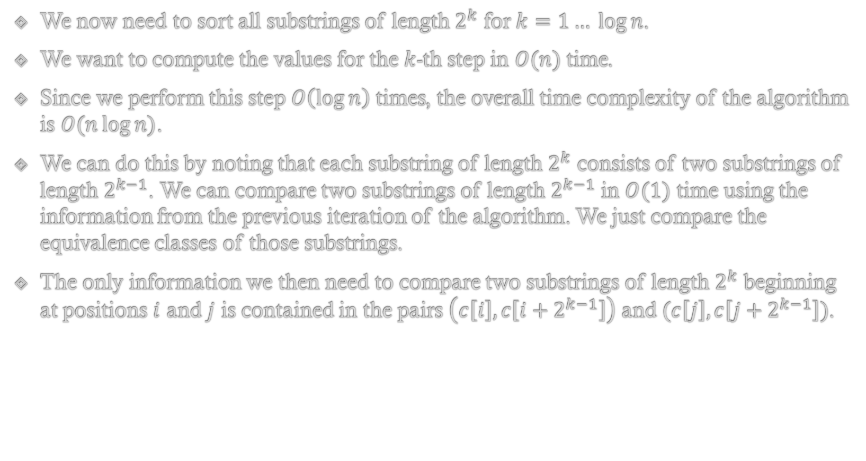
$O(n\log{n})$ approach (continued)
We now need to sort all substrings of length $2^{k}$ for $k=1… \log{n}$.
We want to compute the values for the $k$-th step in $O(n)$ time.
Since we perform this step $O\left(\log{n}\right)$ times, the overall time complexity of the algorithm is $O(n\log{n)}$.
We can do this by noting that each substring of length $2^{k}$ consists of two substrings of length $2^{k−1}$. We can compare two substrings of length $2^{k−1}$ in $O(1)$ time using the information from the previous iteration of the algorithm. We just compare the equivalence classes of those substrings.
The only information we then need to compare two substrings of length $2^{k}$ beginning at positions $i$ and $j$ is contained in the pairs $\left(c\left[i\right], c\left[i+2^{k−1}\right]\right)$ and $(c\left[j\right], c\left[j+2^{k−1}\right])$.

Slide 12
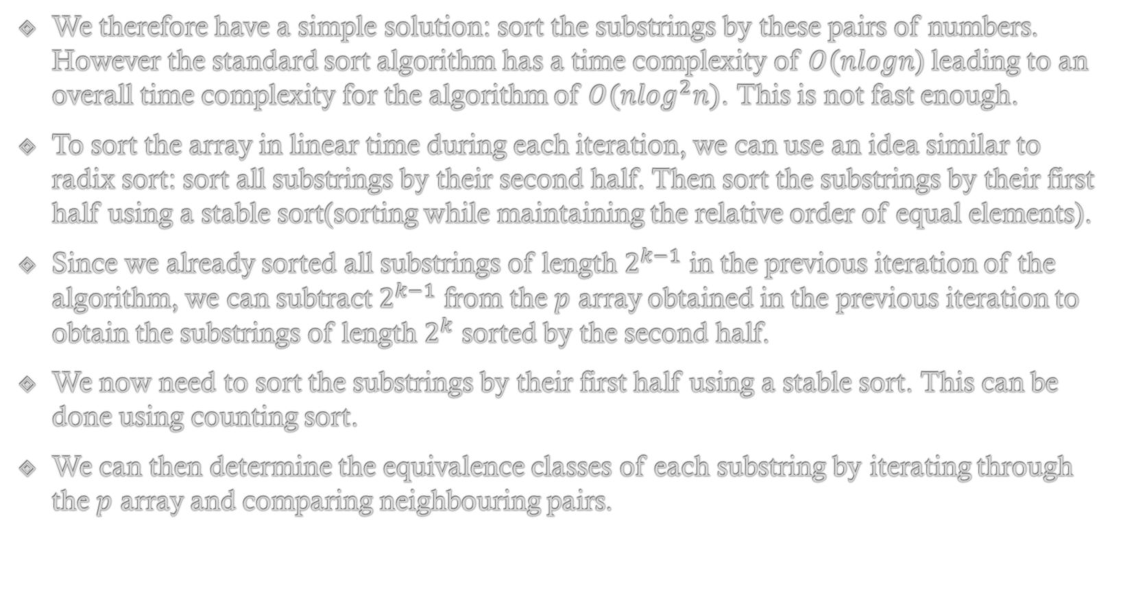
$O(n\log{n})$ approach (continued)
We therefore have a simple solution: sort the substrings by these pairs of numbers. However the standard sort algorithm has a time complexity of $O(nlogn$) leading to an overall time complexity for the algorithm of $O(n\log^{2}n)$. This is not fast enough.
To sort the array in linear time during each iteration, we can use an idea similar to radix sort: sort all substrings by their second half. Then sort the substrings by their first half using a stable sort(sorting while maintaining the relative order of equal elements).
Since we already sorted all substrings of length $2^{k−1}$ in the previous iteration of the algorithm, we can subtract $2^{k−1}$ from the $p$ array obtained in the previous iteration to obtain the substrings of length $2^{k}$ sorted by the second half.
We now need to sort the substrings by their first half using a stable sort. This can be done using counting sort.
We can then determine the equivalence classes of each substring by iterating through the $p$ array and comparing neighbouring pairs.

Slide 13
$O(n\log{n})$ approach C++ implementation (continued)
vector<int> pn(n), cn(n);
for (int h = 0; (1 << h) < n; ++h) {
for (int i = 0; i < n; i++) {
pn[i] = p[i] - (1 << h);
if (pn[i] < 0)
pn[i] += n;
}
fill(cnt.begin(), cnt.begin() + classes, 0);
for (int i = 0; i < n; i++)
cnt[c[pn[i]]]++;
for (int i = 1; i < classes; i++)
cnt[i] += cnt[i-1];
for (int i = n-1; i >= 0; i--)
p[--cnt[c[pn[i]]]] = pn[i];
cn[p[0]] = 0;
classes = 1;
for (int i = 1; i < n; i++) {
pair<int, int> cur = {c[p[i]], c[(p[i] + (1 << h)) % n]};
pair<int, int> prev = {c[p[i-1]], c[(p[i-1] + (1 << h)) % n]};
if (cur != prev)
++classes;
cn[p[i]] = classes - 1;
}
c.swap(cn);
}
return p;
}

Slide 14
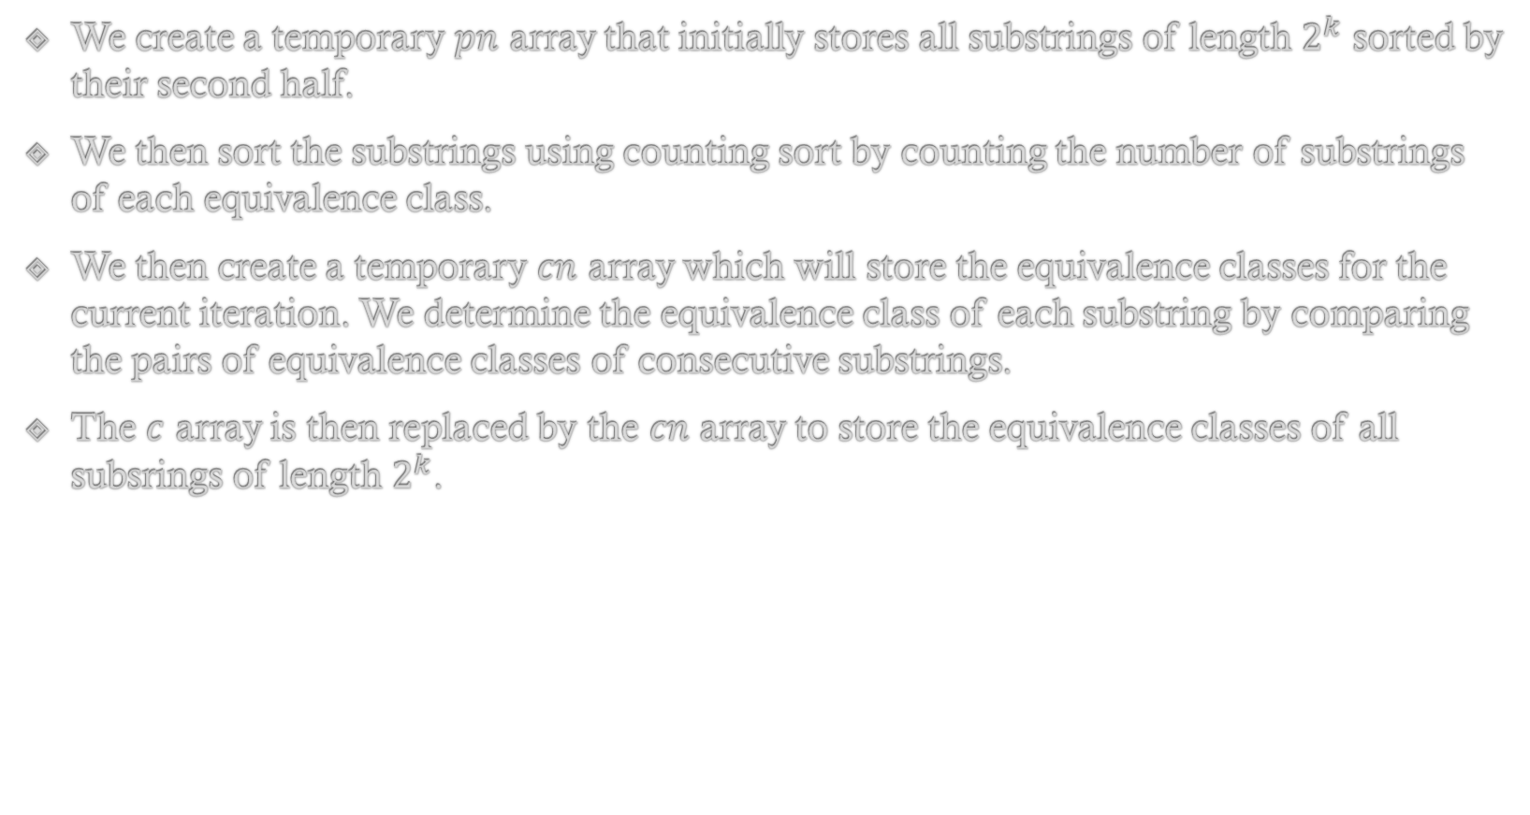
$O(n\log{n})$ approach (continued)
We create a temporary $pn$ array that initially stores all substrings of length $2^{k}$ sorted by their second half.
We then sort the substrings using counting sort by counting the number of substrings of each equivalence class.
We then create a temporary $cn$ array which will store the equivalence classes for the current iteration. We determine the equivalence class of each substring by comparing the pairs of equivalence classes of consecutive substrings.
The $c$ array is then replaced by the $cn$ array to store the equivalence classes of all subsrings of length $2^{k}$.

Slide 15
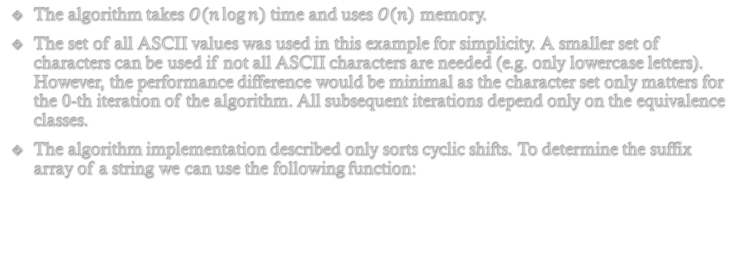
$O(n\log{n})$ approach (continued)
The algorithm takes $O(n\log{n})$ time and uses $O(n)$ memory.
The set of all ASCII values was used in this example for simplicity. A smaller set of characters can be used if not all ASCII characters are needed (e.g. only lowercase letters). However, the performance difference would be minimal as the character set only matters for the $0$-th iteration of the algorithm. All subsequent iterations depend only on the equivalence classes.
The algorithm implementation described only sorts cyclic shifts. To determine the suffix array of a string we can use the following function:
vector<int> suffix_array_construction(string s) {
s += "$";
vector<int> sorted_shifts = sort_cyclic_shifts(s); sorted_shifts.erase(sorted_shifts.begin());
return sorted_shifts;
}

Slide 16
$O(n\log{n})$ approach (continued)
The function appends the ‘$’ character, sorts the cyclic shifts of the input string, and deletes the string representing the empty suffix(the first string after all cyclic shifts are sorted.

Slide 17

Applications of suffix arrays
Finding a substring in a given string:
  If we are required to find a substring $s$ in some string $t$, we can do this using a suffix array.
  We can create a suffix array of $t$ in $O($|t|log|t|) time. If a substring $s$ appears within a string $t$, then it occurs as a prefix of some suffix of $t$. Because we have all suffixes of $t$ in sorted order, we can determine if a string $s$ appears as a substring of $t$ by using binary search and comparing it to the suffixes of $t$. Since comparisons take $O(s)$ time and there are $|t|$ suffixes of $t$, we can determine if $s$ appears within $t$ in $O\left(\left|s\right|\log\left|t\right|\right)$ time with $O\left(\left|t\right|\log\left|t\right|\right)$ preprocessing.s

Slide 18
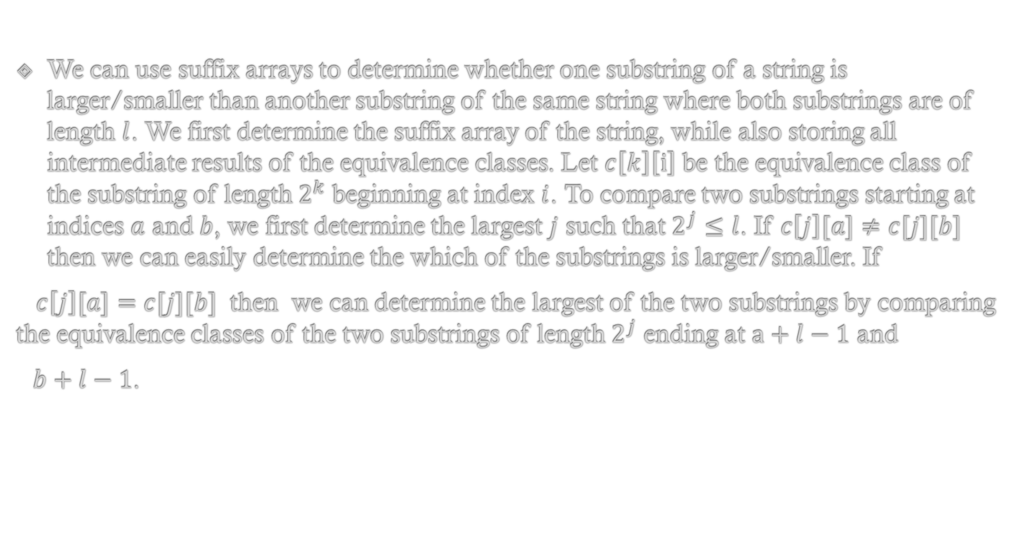
Applications of suffix arrays (2)
We can use suffix arrays to determine whether one substring of a string is larger/smaller than another substring of the same string where both substrings are of length $l$. We first determine the suffix array of the string, while also storing all intermediate results of the equivalence classes. Let $c\left[k\right]\left[i\right]$ be the equivalence class of the substring of length $2^{k}$ beginning at index $i$. To compare two substrings starting at indices $a$ and $b$, we first determine the largest $j$ such that $2^{j}≤l$. If $c\left[j\right][a]≠c[j][b]$ then we can easily determine the which of the substrings is larger/smaller. If
$c\left[j\right][a]=c[j][b]$ then we can determine the largest of the two substrings by comparing the equivalence classes of the two substrings of length $2^{j}$ ending at $a+l−1$ and
$b+l−1$.

Slide 19
Sources
Suffix Array - Algorithms for Competitive Programming (cp-algorithms.com)

